Slide 1
Styling Links and Lists

Slide 2

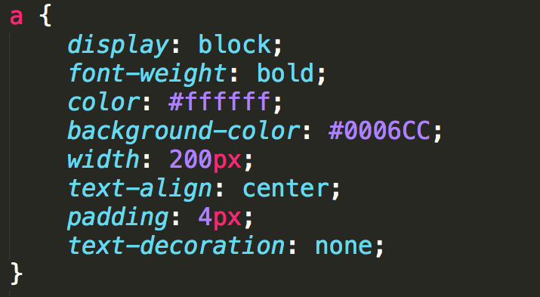

Anchor Links
Links can take on all of the usual styles as well as text-decoration

Slide 3


“Buttons”
Many designers try to make their links look like buttons.
Be semantic, if you want a button use the <button> element instead.

Slide 4
States
Some links are blue, some are purple, etc. Why???
a:link: a normal, unvisited link
a:visited has been visited
a:hover activated by mouse (touchscreens….?)
a:focus activated with the keyboard
a:active is being clicked

Slide 5
Precedence of Rules
a:hover MUST come after a:link
a:visited and a:active MUST come after a:hover

Slide 6
Example

Slide 7
Styling Lists
Number of properties beyond font, margin, etc.
list-style-type
list-style-image
list-style-position
list-style

Slide 8

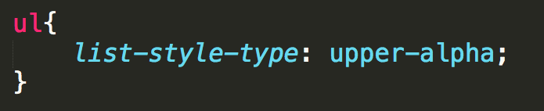

list-style-type
list-style-type
ordered lists
lower-roman, upper-roman, decimal, decimal-leading-zero, upper-alpha, lower-alpha, hebrew, armenian, …..

Slide 9
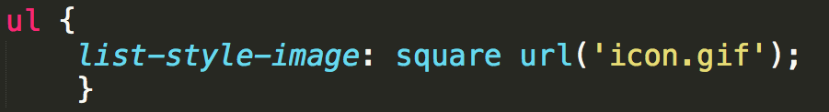
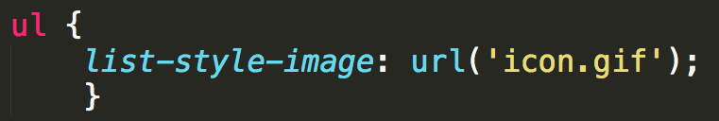
List styles
list-style-type
unordered lists
Override the default marker with circles, discs, or squares
list-style-image
Use a custom image instead of traditional marker

Slide 10
Example

Slide 11
Review
At this point you have learned how to write rules for the tags.
Embrace the many tools that are available to help you design your site.
http://chrispederick.com/work/web-developer/
http://css3generator.com/
Do web search for “Developer Tools”

Slide 12

Acknowledgements/Contributions
These slides are Copyright 2015- Colleen van Lent as part of http://www.intro-webdesign.com/ and made available under a Creative Commons Attribution Non-Commercial 4.0 License. Please maintain this last slide in all copies of the document to comply with the attribution requirements of the license. If you make a change, feel free to add your name and organization to the list of contributors on this page as you republish the materials.
Initial Development: Colleen van Lent , University of Michigan School of Information

